Slide 1


Groove Radio: A Bayesian Hierarchical Model for Personalized Playlist Generation
Shay Ben-Elazar, Gal Lavee, Noam Koenigstein,
Oren Barkan, Hilik Berezin, Ulrich Paquet, Tal Zaccai
ACM Conference on Web Search and Data Mining (WSDM'17), Cambridge UK, February 2017.
Presented by: Noam Koenigstein

Slide 2
Abstract
This talk will present an algorithm designed for Microsoft's Groove music service, which serves millions of users world wide. We consider the problem of automatically generating personalized music playlists based on queries containing a ``seed'' artist and the listener's user ID. Playlist generation may be informed by a number of information sources including: user specific listening patterns, domain knowledge encoded in a taxonomy, acoustic features of audio tracks, and overall popularity of tracks and artists. The importance assigned to each of these information sources may vary depending on the specific combination of user and seed artist.
We present a method based on a variational Bayes solution for learning the parameters of a model containing a four-level hierarchy of global preferences, genres, sub-genres and artists. The proposed model further incorporates a personalization component for user-specific preferences. Empirical evaluations on both proprietary and public datasets demonstrate the effectiveness of the algorithm and showcase the contribution of each of its components.

Slide 3

Groove Radio

Slide 4

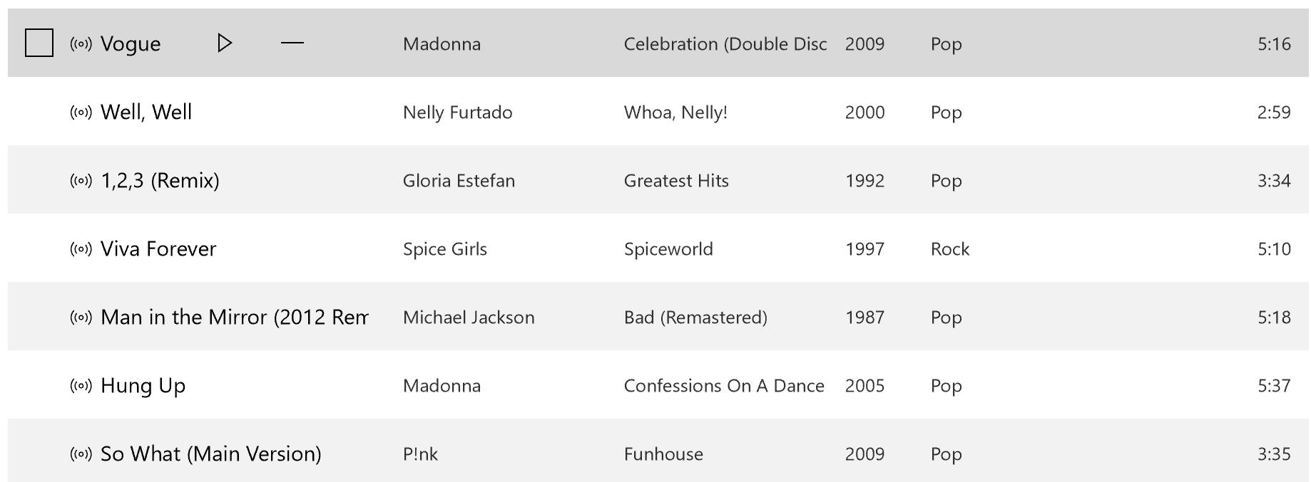

Slide 5
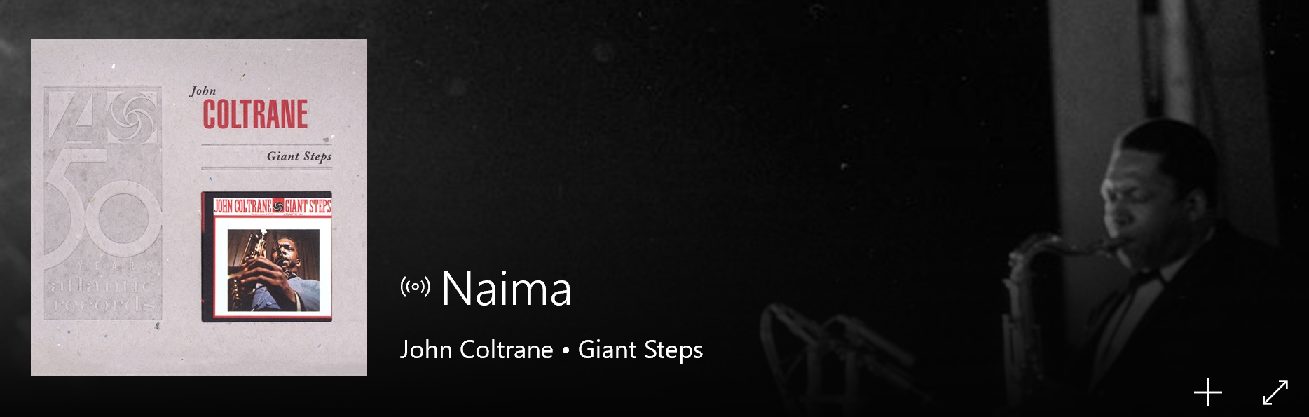
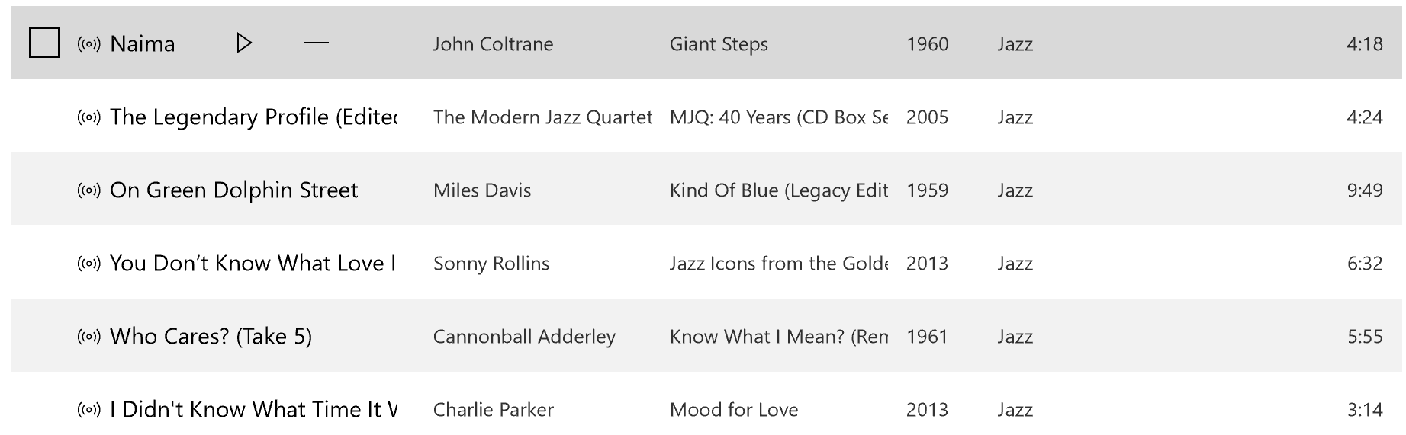

Slide 6
The Task
Goal: Given a seed artist, generate a track playlist
Millions of users, tens of millions of tracks
Support different type of similarities
Personalization
Real world online execution

Slide 7
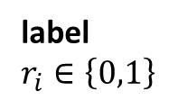
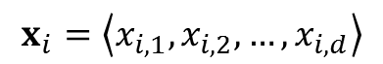
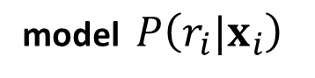
How can we choose the next track?
Goal: Given a seed artist, generate a tracks playlist.
context
Seed artist
Track 1
Track 2
….
Track i-1
Track i
Track i+1
label
$r_{i}∈\left\{0,1\right\}$
model $P\left(r_{i}|x_{i}\right)$
$$x_{i}=\left\langle x_{i,1},x_{i,2},…,x_{i,d}\right\rangle$$

Slide 8
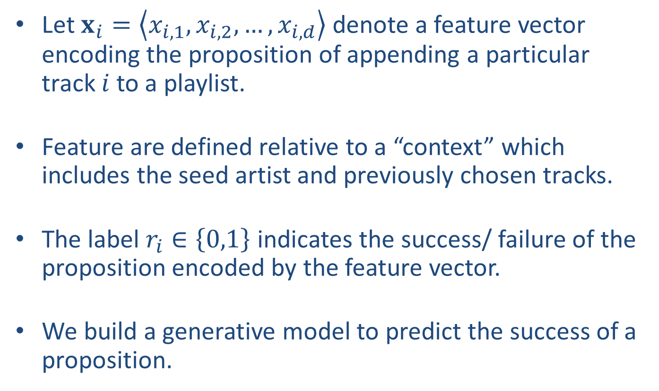
Creating Playlists – A Classification Problem
Let $x_{i}=\left\langle x_{i,1},x_{i,2},…,x_{i,d}\right\rangle$ denote a feature vector encoding the proposition of appending a particular track $i$ to a playlist.
Feature are defined relative to a “context” which includes the seed artist and previously chosen tracks.
The label $r_{i}∈\left\{0,1\right\}$ indicates the success/ failure of the proposition encoded by the feature vector.
We build a generative model to predict the success of a proposition.

Slide 9
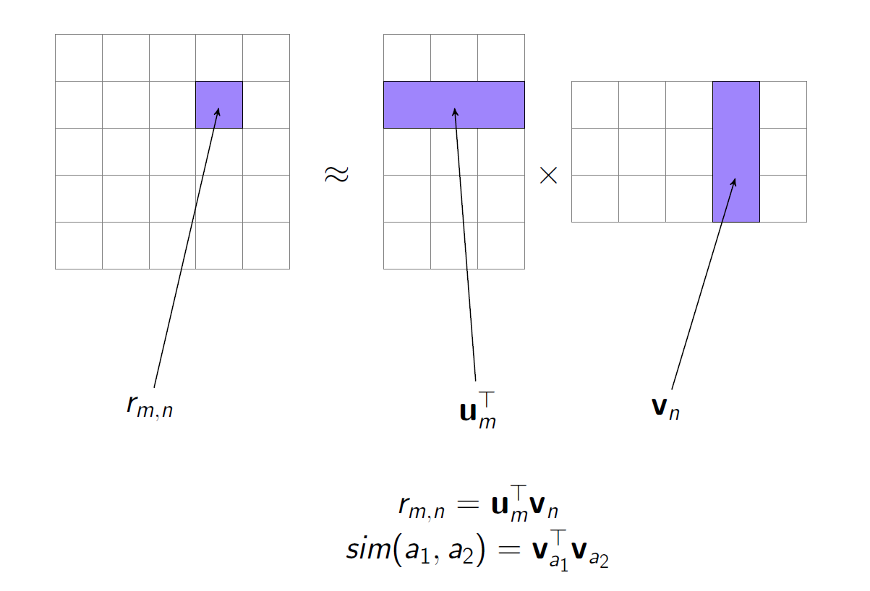
Types of Similarity - Usage

Slide 10
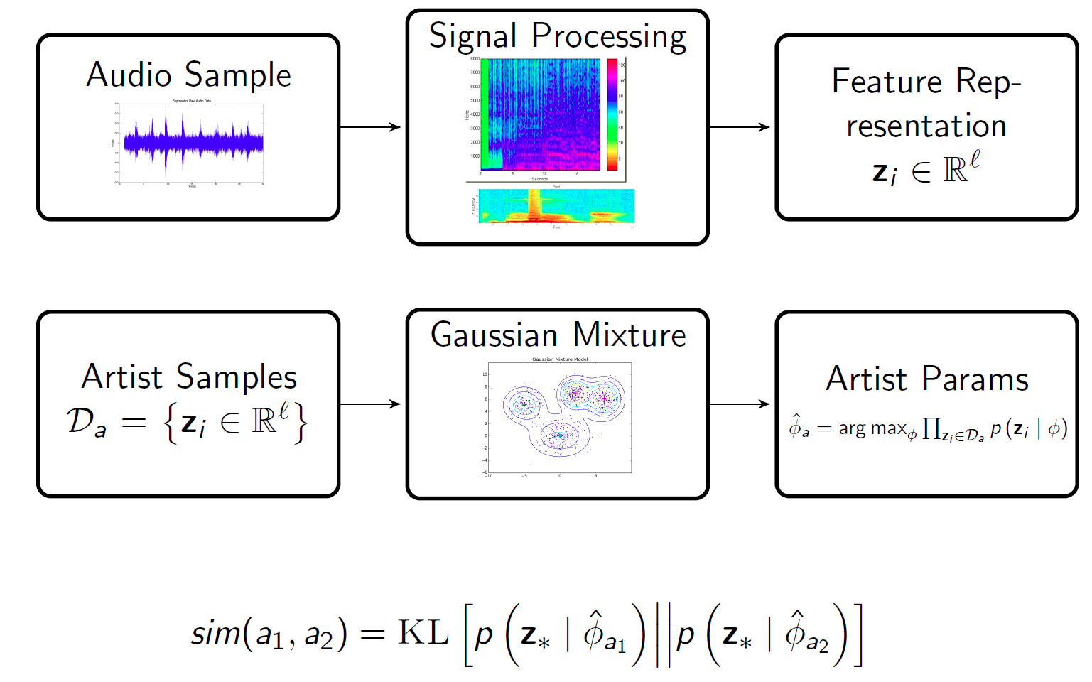
Types of Similarity - Audio
Audio Features:
Spectral distribution with GMMs:
Defining acoustic similarity:

Slide 11
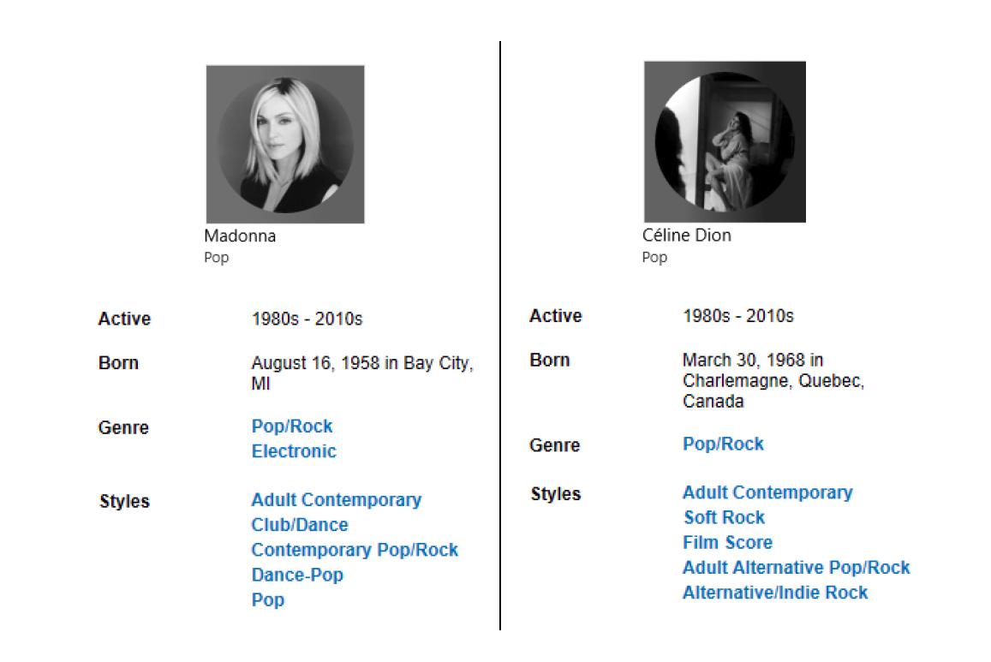
Types of similarity – Meta-data

Slide 12
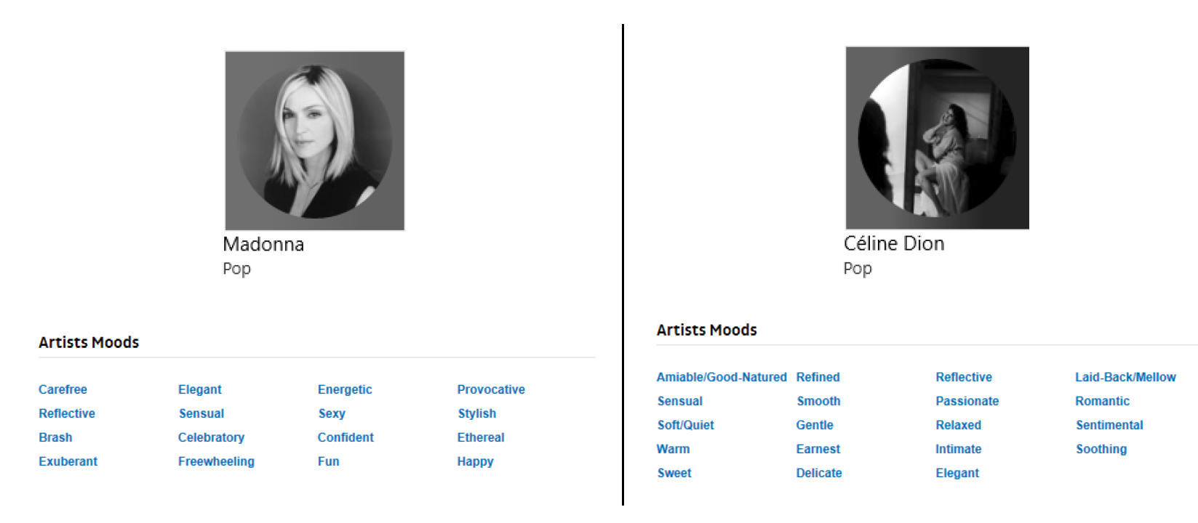
Types of similarity – Meta-data

Slide 13
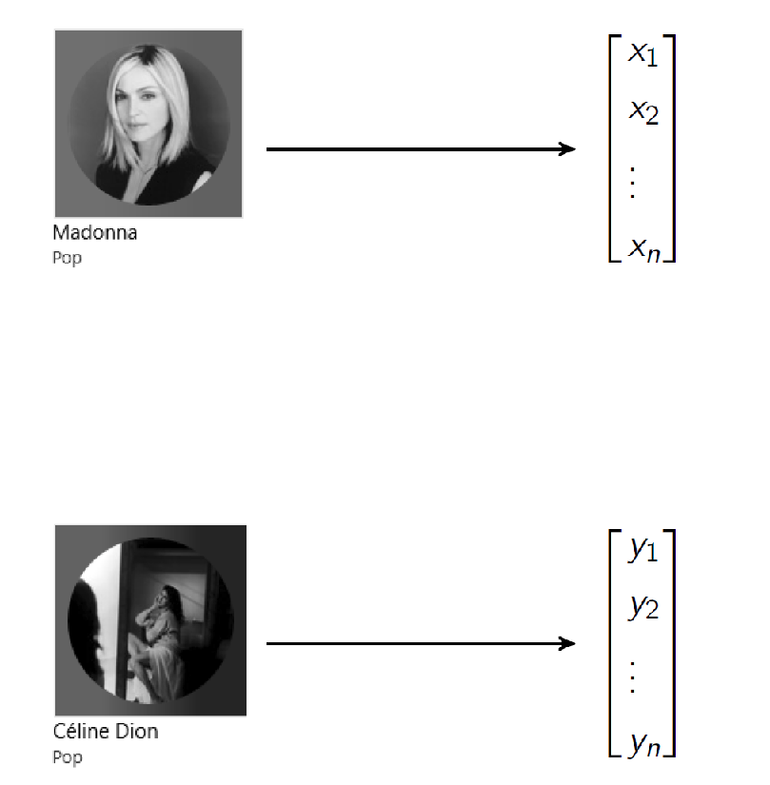
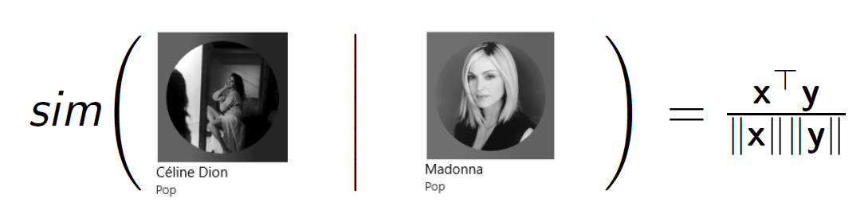
Types of similarity – Meta-data
Warm
Provocative

Slide 14
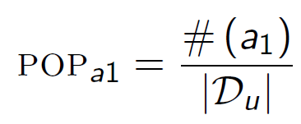
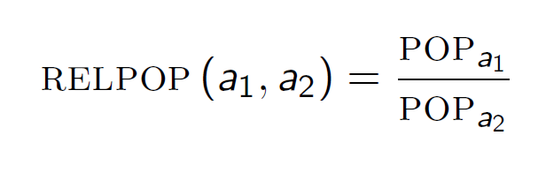
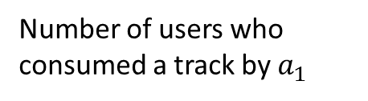
Types of Similarity - Popularity
Number of users who consumed a track by $a_{1}$
Total users in the dataset

Slide 15
The classification problem
context
Seed artist
Track 1
Track 2
….
Track i-1
Track i
Track i+1
label
$r_{i}∈\left\{0,1\right\}$
model $P\left(r_{i}|x_{i}\right)$
$$x_{i}=\left\langle x_{i,1},x_{i,2},…,x_{i,d}\right\rangle$$

Slide 16
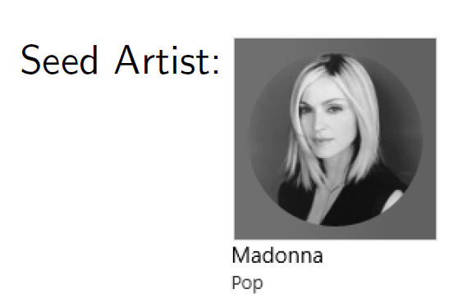
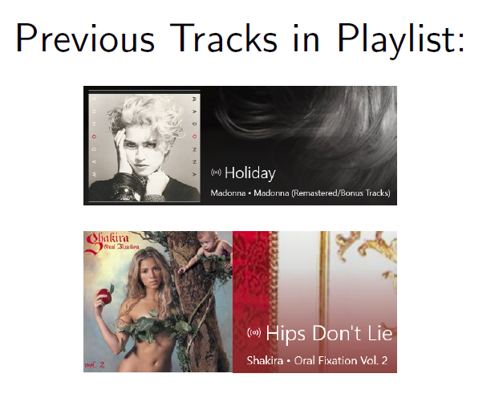

The classification problem
context
Seed artist:
Previous tracks in Playlist:
Candidate Track:
Candidate artist to seed artist similarity
Candidate artist to previous artist similarity
Candidate track to previous track similarity

Slide 17
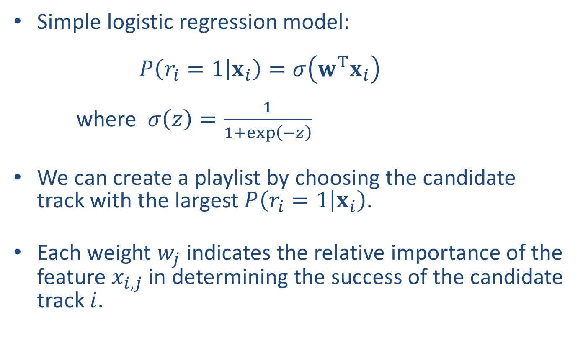
A Naïve Solution
Simple logistic regression model: $P\left(r_{i}=1 | x_{i}\right)=σ\left(w^{T}x_{i}\right)$ where $σ\left(z\right)=\frac{1}{1+\exp\left(−z\right)}$
We can create a playlist by choosing the candidate track with the largest $P\left(r_{i}=1 | x_{i}\right)$.
Each weight $w_{j}$ indicates the relative importance of the feature $x_{i,j}$ in determining the success of the candidate track $i$.

Slide 18
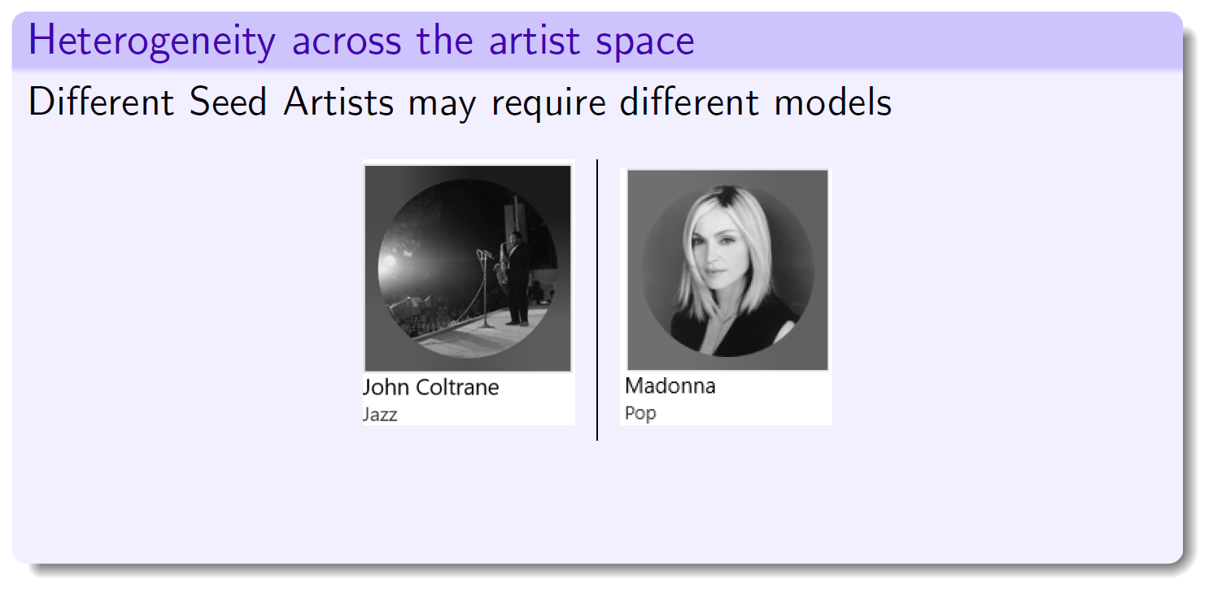
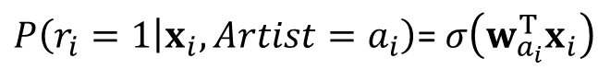
Different models for different artists
$P\left(r_{i}=1 | x_{i}, Artist=a_{i}\right)$= $σ\left(w_{a_{i}}^{T}x_{i}\right)$

Slide 19
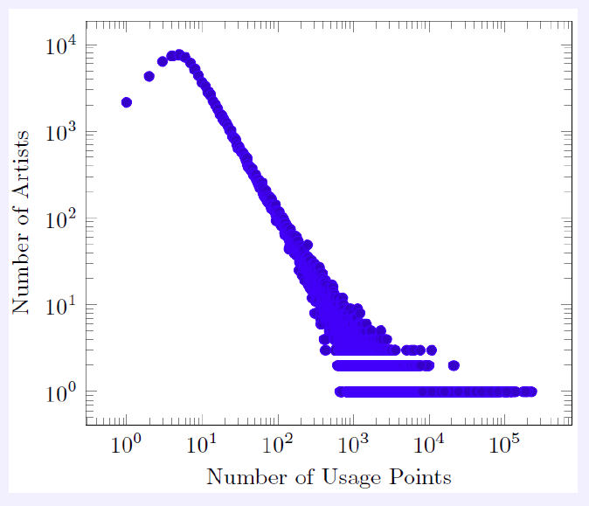
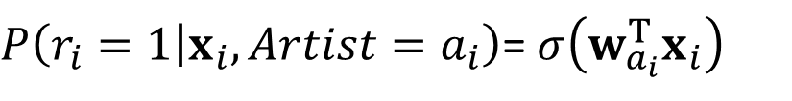
Different models for different artists
$P\left(r_{i}=1 | x_{i}, Artist=a_{i}\right)$= $σ\left(w_{a_{i}}^{T}x_{i}\right)$

Slide 20
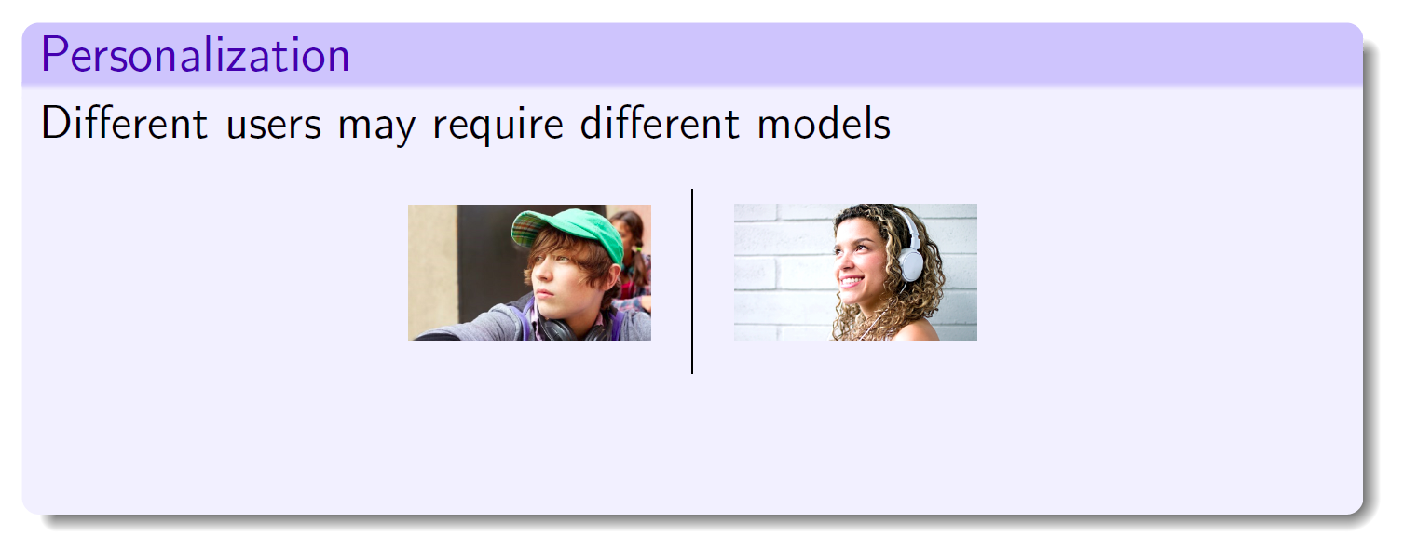
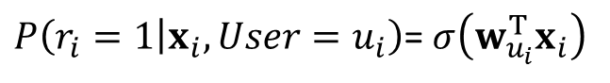
Different models for different users
$P\left(r_{i}=1 | x_{i}, User=u_{i}\right)$= $σ\left(w_{u_{i}}^{T}x_{i}\right)$

Slide 21
Our Approach
We want to construct a model with the following properties:
Affords music domain heterogeneity
Affords user personalization
Deals gracefully with “coldness”
We achieve this by using the following:
Leveraging the well-understood hierarchical taxonomy of the music domain
A generative Bayesian approach with informative priors
Variational Bayes inference to model uncertainty

Slide 22

The Music Domain Taxonomy

Slide 23
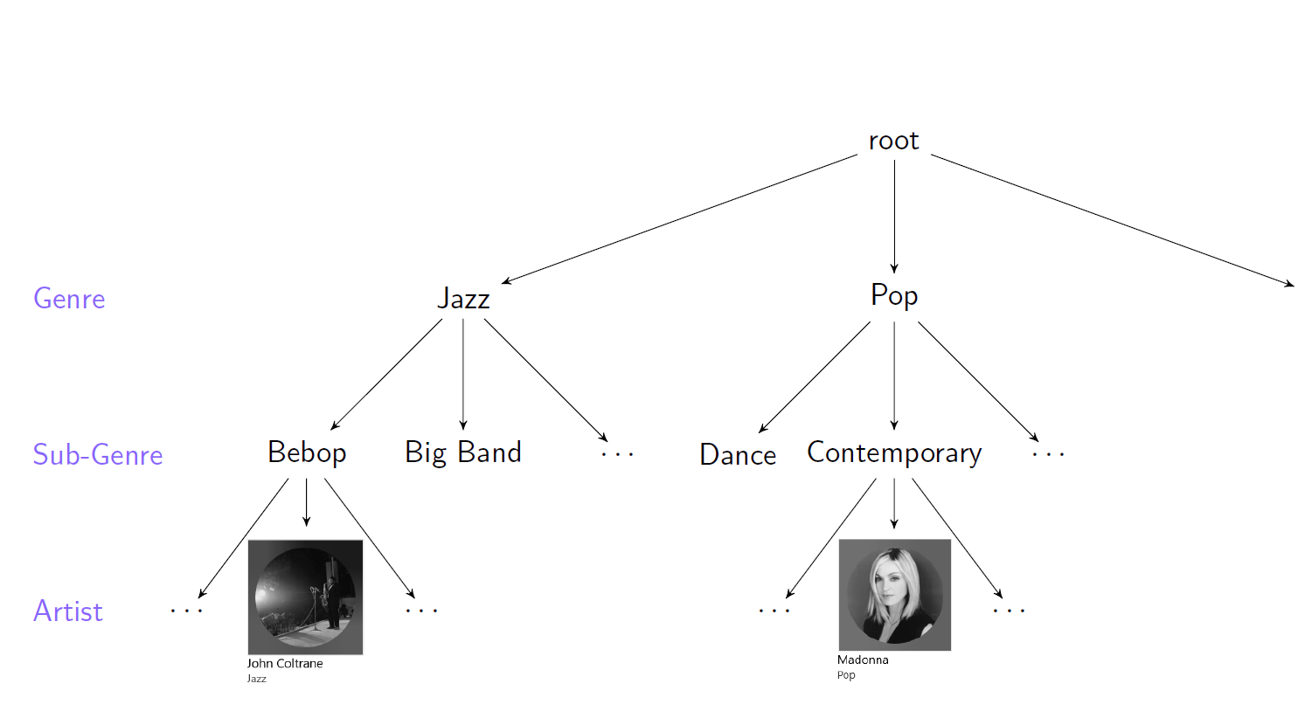
The Music Domain Taxonomy

Slide 24
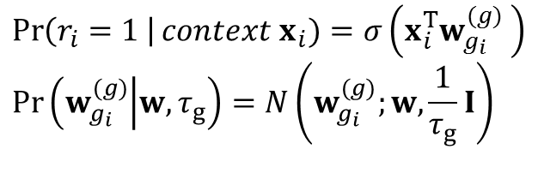
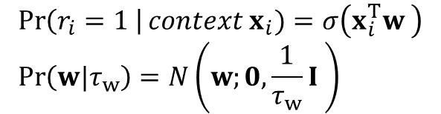
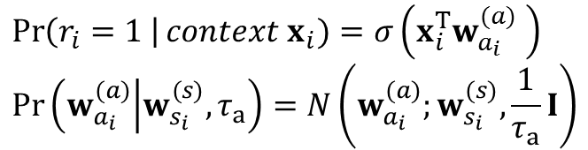
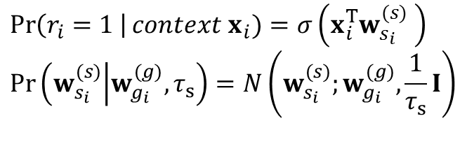
Hierarchical Model
Naïve model:
$$\operatorname{Pr}\left(r_{i}=1 \right|context x_{i})=σ\left(x_{i}^{T}w \right) \\ \operatorname{Pr}\left(w|τ_{w}\right)=N\left(w;0, \frac{1}{τ_{w}}I \right)$$
Genre model:
$$\operatorname{Pr}\left(r_{i}=1 \right|context x_{i})=σ\left(x_{i}^{T}w_{g_{i}}^{(g)} \right) \\ \operatorname{Pr}\left(w_{g_{i}}^{(g)} | w,τ_{g}\right)=N\left(w_{g_{i}}^{(g)};w,\frac{1}{τ_{g}}I\right)$$
Sub-genre model:
Artist model:
$$\operatorname{Pr}\left(r_{i}=1 \right|context x_{i})=σ\left(x_{i}^{T}w_{s_{i}}^{(s)} \right) \\ \operatorname{Pr}\left(w_{s_{i}}^{(s)} | w_{g_{i}}^{(g)},τ_{s}\right)=N\left(w_{s_{i}}^{(s)};w_{g_{i}}^{(g)},\frac{1}{τ_{s}}I\right)$$
$$\operatorname{Pr}\left(r_{i}=1 \right|context x_{i})=σ\left(x_{i}^{T}w_{a_{i}}^{(a)} \right) \\ \operatorname{Pr}\left(w_{a_{i}}^{(a)} | w_{s_{i}}^{(s)},τ_{a}\right)=N\left(w_{a_{i}}^{(a)};w_{s_{i}}^{(s)},\frac{1}{τ_{a}}I\right)$$

Slide 25
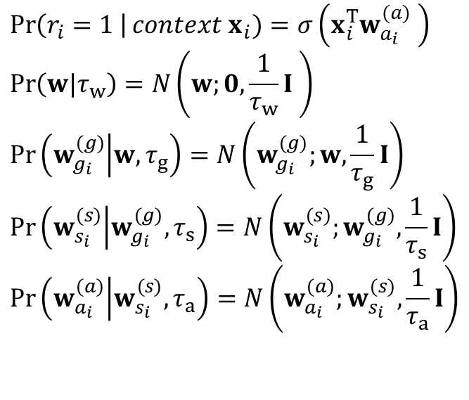
Hierarchical Model Cont.
Fully hierarchical model:
$$\operatorname{Pr}\left(r_{i}=1 \right|context x_{i})=σ\left(x_{i}^{T}w_{a_{i}}^{(a)} \right) \\ \operatorname{Pr}\left(w|τ_{w}\right)=N\left(w;0, \frac{1}{τ_{w}}I \right)$$
$$\operatorname{Pr}\left(w_{g_{i}}^{(g)} | w,τ_{g}\right)=N\left(w_{g_{i}}^{(g)};w,\frac{1}{τ_{g}}I\right)$$
$$\operatorname{Pr}\left(w_{s_{i}}^{(s)} | w_{g_{i}}^{(g)},τ_{s}\right)=N\left(w_{s_{i}}^{(s)};w_{g_{i}}^{(g)},\frac{1}{τ_{s}}I\right)$$
$$\operatorname{Pr}\left(w_{a_{i}}^{(a)} | w_{s_{i}}^{(s)},τ_{a}\right)=N\left(w_{a_{i}}^{(a)};w_{s_{i}}^{(s)},\frac{1}{τ_{a}}I\right)$$

Slide 26
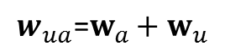
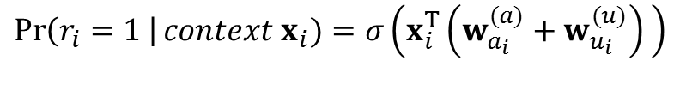
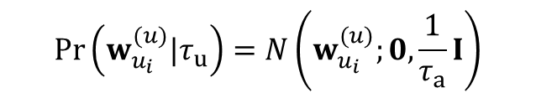
Personalized Model
Per user parameters:
$$w_{ua}\text{=}w_{a}+w_{u}$$
$$\operatorname{Pr}\left(r_{i}=1 \right|context x_{i})=σ\left(x_{i}^{T}\left(w_{a_{i} }^{(a)}+w_{u_{i} }^{(u)}\right) \right)$$
$$\operatorname{Pr}\left(w_{u_{i} }^{(u)}|τ_{u}\right)=N\left(w_{u_{i} }^{(u)};0,\frac{1}{τ_{a}}I\right)$$

Slide 27
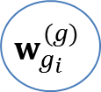
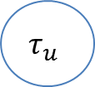




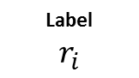

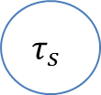
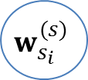

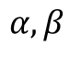



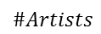
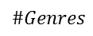
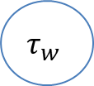
Graphical Model
$$τ_{w}$$
$$w$$
$$τ_{g}$$
$$α,β$$
$$w_{g_{i}}^{(g)}$$
$$τ_{s}$$
$$τ_{a}$$
$$\#Genres$$
$$τ_{u}$$
$$w_{s_{i}}^{(s)}$$
$$\#Subgenres$$
$$w_{u_{i}}^{(u)}$$
$$w_{a_{i}}^{(a)}$$
$$\#Users$$
$$\#Artists$$
$$x_{i}$$
$$\text{Label}$$
$$r_{i}$$
$$\#Data$$

Slide 28
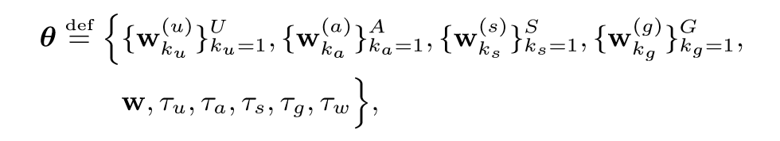
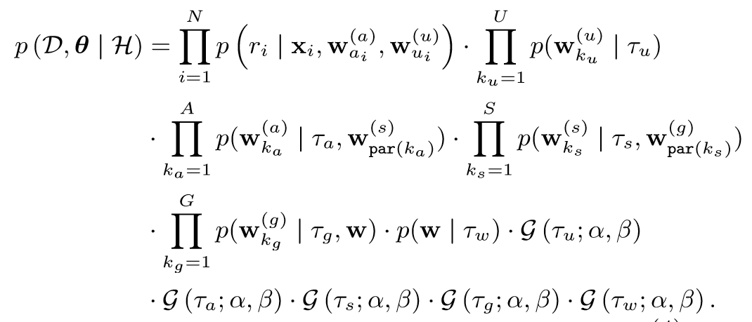
The Joint Probability

Slide 29
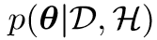
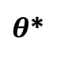

Inference Approaches
$$θ$$
$θ$*
MAP (maximum a posteriori)
Mean field / Variational Bayes (VB)
Laplace
Expectation Propagation (EP)
Markov chain
Monte Carlo (MCMC)

Slide 30
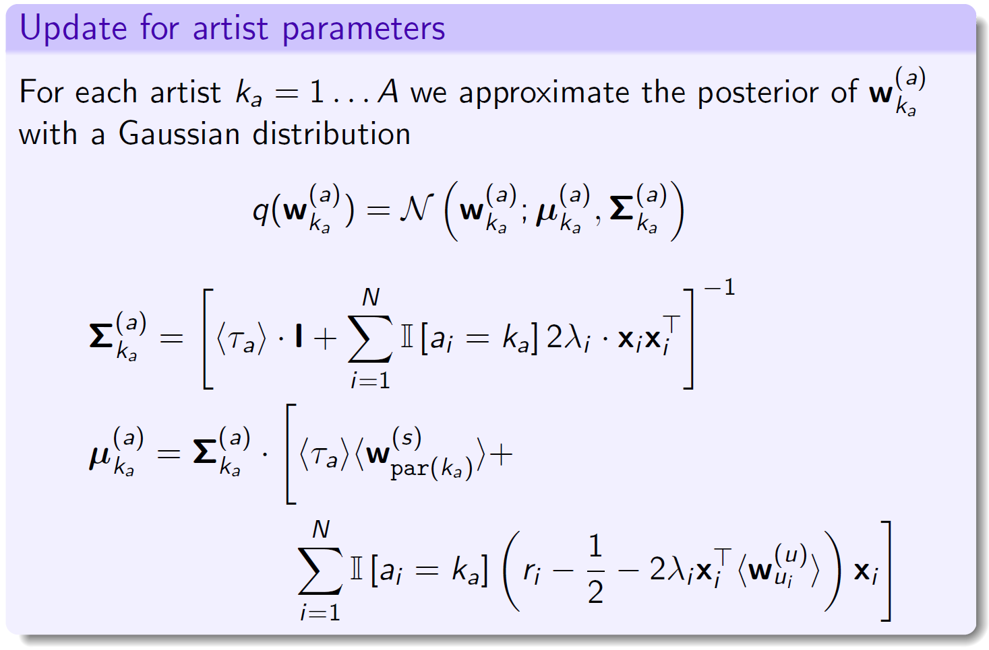
Learning Artists

Slide 31
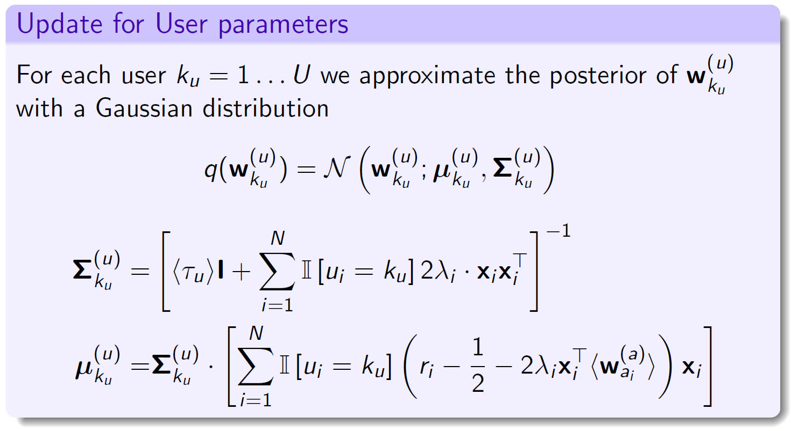
Learning Users

Slide 32
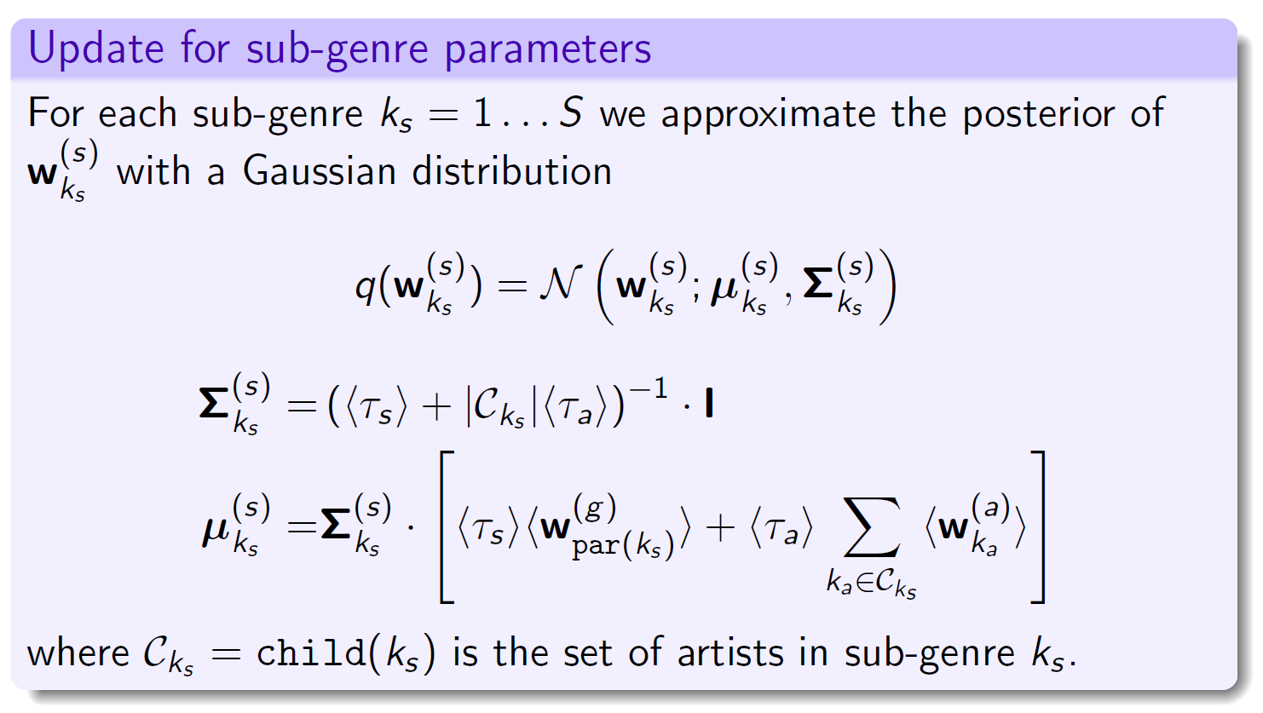
Learning Sub-Genres

Slide 33

Learning Genres

Slide 34

The Global Prior

Slide 35

The Precision Parameters

Slide 36


Practical Considerations
We wish to ensure different playlists even for similar activations.
We pre-compute a candidate list of $M=1000$ tracks for each seed artist.
Discrete multinomial transition probabilities using the softmax function:
Parameter $s$ tunes the desired degree of divrersity.
$$p_{m}=\frac{e^{s⋅{\hat{r}}_{m}}}{\sum_{i=1}^{M}{e^{s⋅{\hat{r}}_{i}}}}$$

Slide 37
Datasets
Groove Music- a proprietary dataset from Groove music service. Positive labels are assigned to ‘true’ transitions in a user’s listening history when both tracks were played till completion. Negative labels indicate transitions where the second track was skipped in mid-play.
30Music- a publicly available dataset of user playlists. Positive labels are assigned to tracks appearing in a playlist. Negatively labeled examples were obtained by uniformly sampling from tracks that did not appear.

Slide 38

Dataset Statistics

Slide 39




Groove Music Dataset
$$w$$
$$x_{i}$$
$$\text{Label}$$
$$r_{i}$$

Slide 40




Groove Music Dataset
$$w$$
$$w_{g_{i}}^{(g)}$$
$$x_{i}$$
$$\text{Label}$$
$$r_{i}$$

Slide 41





Groove Music Dataset
$$w$$
$$w_{s_{i}}^{(s)}$$
$$w_{g_{i}}^{(g)}$$
$$x_{i}$$
$$\text{Label}$$
$$r_{i}$$

Slide 42



Groove Music Dataset
$$w$$
$$w_{s_{i}}^{(s)}$$
$$w_{g_{i}}^{(g)}$$
$$w_{a_{i}}^{(a)}$$
$$x_{i}$$
$$\text{Label}$$
$$r_{i}$$

Slide 43











Groove Music Dataset
$$τ_{w}$$
$$w$$
$$τ_{g}$$
$$α,β$$
$$τ_{s}$$
$$w_{g_{i}}^{(g)}$$
$$τ_{a}$$
$$τ_{u}$$
$$w_{s_{i}}^{(s)}$$
$$w_{u_{i}}^{(u)}$$
$$w_{a_{i}}^{(a)}$$
$$x_{i}$$
$$\text{Label}$$
$$r_{i}$$

Slide 44

Groove Music Dataset
$$τ_{w}$$
$$w$$
$$τ_{g}$$
$$α,β$$
$$τ_{s}$$
$$w_{g_{i}}^{(g)}$$
$$τ_{a}$$
$$τ_{u}$$
$$w_{s_{i}}^{(s)}$$
$$w_{u_{i}}^{(u)}$$
$$w_{a_{i}}^{(a)}$$
$$x_{i}$$
$$\text{Label}$$
$$r_{i}$$

Slide 45

30Music Dataset
$$τ_{w}$$
$$w$$
$$τ_{g}$$
$$α,β$$
$$τ_{s}$$
$$w_{g_{i}}^{(g)}$$
$$τ_{a}$$
$$τ_{u}$$
$$w_{s_{i}}^{(s)}$$
$$w_{u_{i}}^{(u)}$$
$$w_{a_{i}}^{(a)}$$
$$x_{i}$$
$$\text{Label}$$
$$r_{i}$$

Slide 46

Feature Contribution

Slide 47


Slide 48
Conclusions
We described a real world playlist generation algorithm
Account for the heterogeneity across artists and genres
Support personalization
Graceful handling of “coldness”
A Bayesian model that utilizes the domain’s taxonomy
Efficient variational Bayes inference

Slide 49
Thank You!

